Slide 1
SC1015 Mini Project: Efficient Music
Recommender System
Our Music Playlists
Search
Home
Library
Syed Ali Redha Alsagoff (U2340588F)
Huang Yongjian (U2320879D)
Ma Jinlin (U2323340E)
FDDA Team 5
Notes:
Hello there, we are Ali, Yongjian and Jinlin from FDDA Group 5, and we will be presenting our project for SC1015 titled: Features for an efficient recommender system. We hope you enjoy our presentation.

Slide 2
Problem Statement
Search
How can companies maximise the use of machine learning to recommend quality songs efficiently?
Home
Library
Notes:
Now, let's move onto our practical motivation

Slide 3
Practical Motivation
Search
Home
Library
Notes:
Now, let's move onto our practical motivation

Slide 4
Practical Motivation
Search
Home
- Music recommender systems contain a significant number of features [1].
- Makes robust music recommendation systems computationally expensive
- Lack of good datasets available that include track genre as a feature
Library
Notes:
So, why have we chosen our topic? We chose this problem because firstly, robust music recommender systems make use of many, many features. Novel approaches to recommender systems make use of Deep Learning that engineer even more features for their system[1]. Advanced recommendation systems can make use of many features[2], in the realm of hundreds to even thousands of features to make their recommendations. Hence, to improve the efficiency and resource management, and possibly the quality of recommendations as well, good feature selection is paramount to any music streaming service company, such as Spotify.
A good genre prediction model is important due to the lack of robust datasets with labelled genres. Even in some research literatures in music recommender systems, the teams made use of genre classification models

Slide 5

Leverage on Machine learning
Our Music Playlists
different feature selection techniques
evaluating our model trained

Slide 6

Our Goal
To make an efficient and effective
music recommender system

Slide 7
Two-Pronged Approach
Genre Classification
Feature Selection
Track Genres are crucial in recommending songs, so an effective model should have a good classification model
An efficient model would act quickly, and latency can be quickly reduced using feature selection

Slide 8
Sampling
Search
Home
Library
Notes:
Now, let's move onto our practical motivation

Slide 9

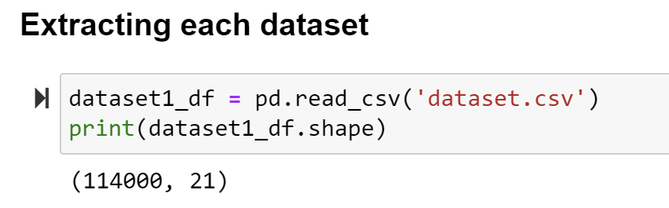
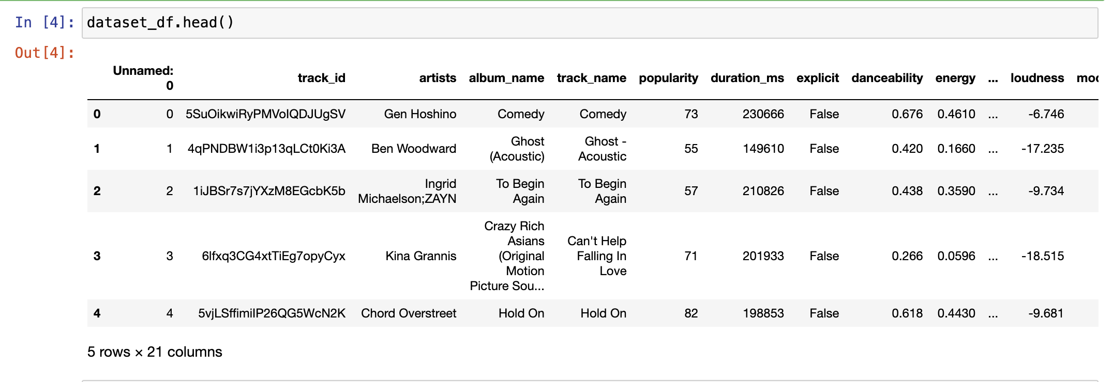
Sampling
Search
Home
For our genre classification model, we made use of a Kaggle dataset, with over 114000 songs and 114 genres
Library
Notes:
Now, let's move onto our practical motivation

Slide 10

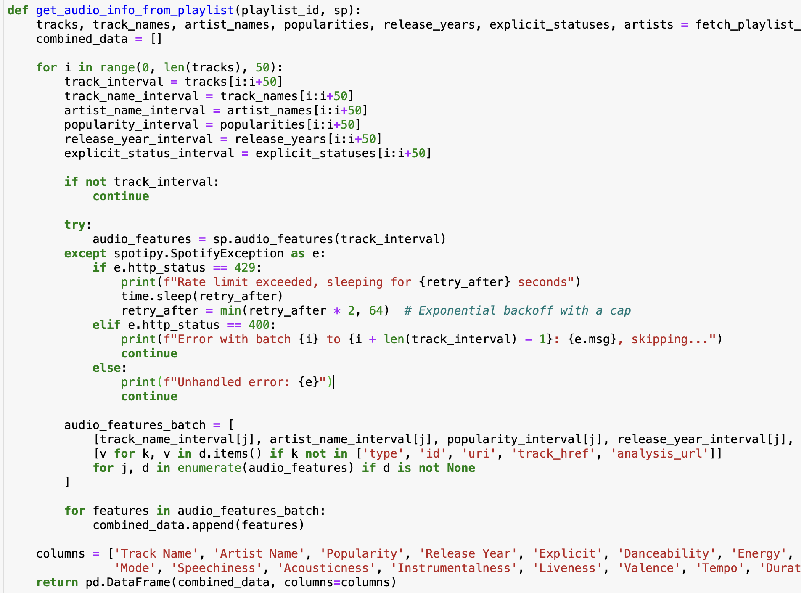
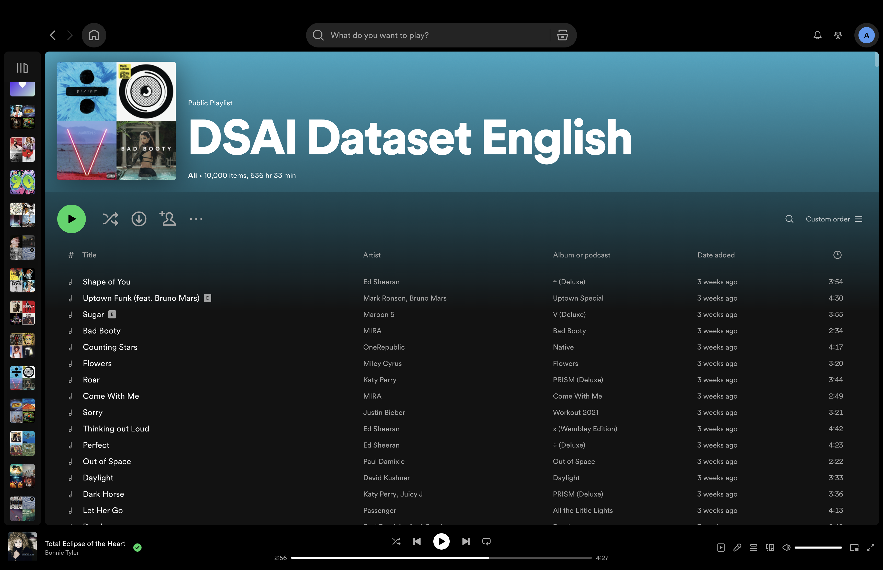
Sampling
Search
Home
Spotify web API to extract song metadata from our playlists
Library
Notes:
Now, let's move onto our practical motivation

Slide 11





Sampling
Search
Home
Spotify web API to extract song metadata from our playlists
Library
Over 11,700 songs
Notes:
Now, let's move onto our practical motivation

Slide 12
Part 1: Genre Classification Model
Our Music Playlists
Search
Home
Library

Slide 13
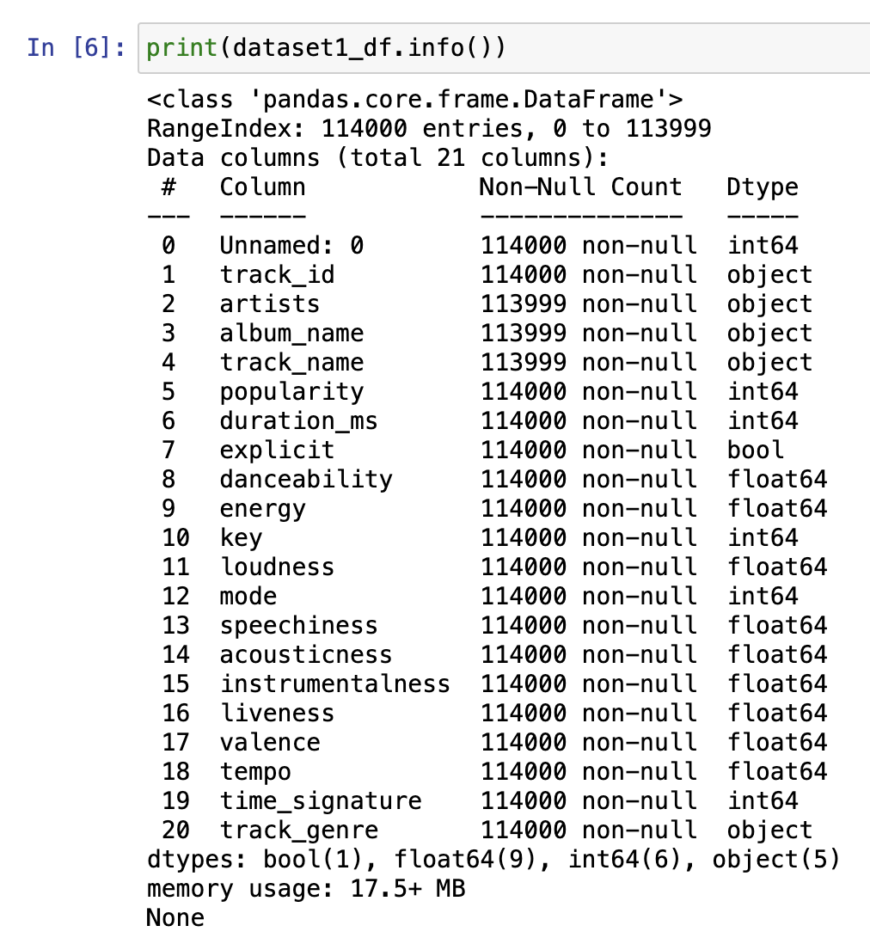
Preliminary Exploration
Data Prep & EDA
Search
Home
We made use of summary statistics and basic exploratory tools to explore our data
Library
We also tried to find which features to clean up or drop from our dataset

Slide 14
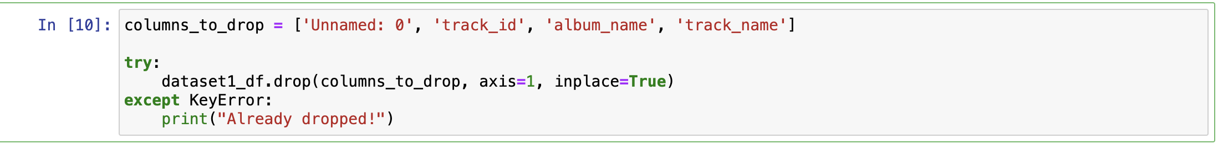
Basic Data Cleaning
Data Prep & EDA
Search
Home
We dropped unwanted columns and removed rows with Na or repeated songs
Library
And we're done with cleaning!....

Slide 15
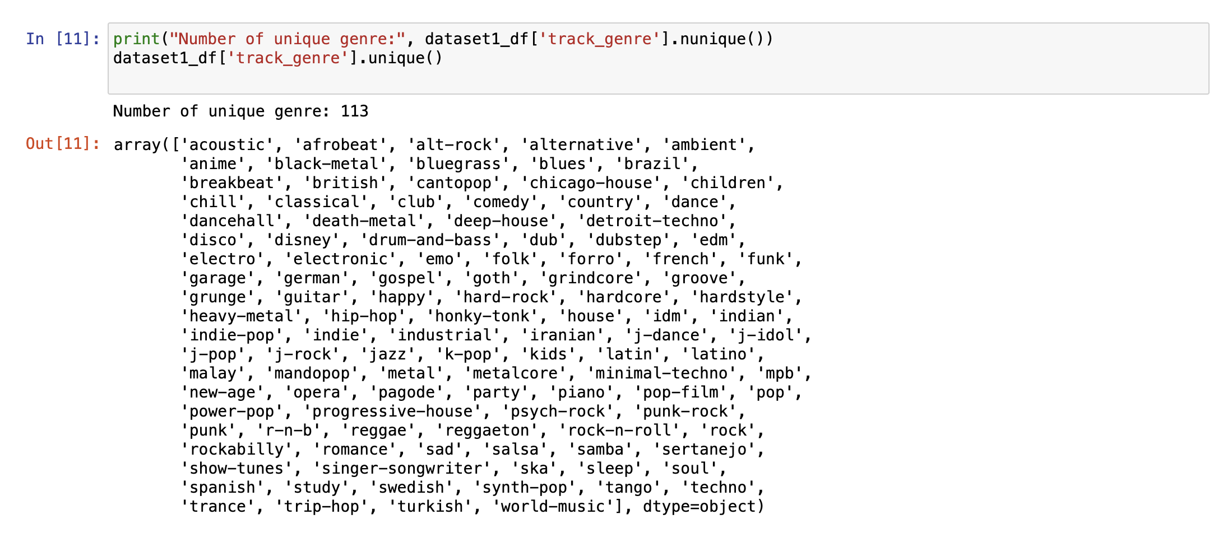
Except no, our genres...
Data Prep & EDA
Search
Home
Library
With over 113 genres, it will be too difficult to train an accurate classification model using just the metadata

Slide 16
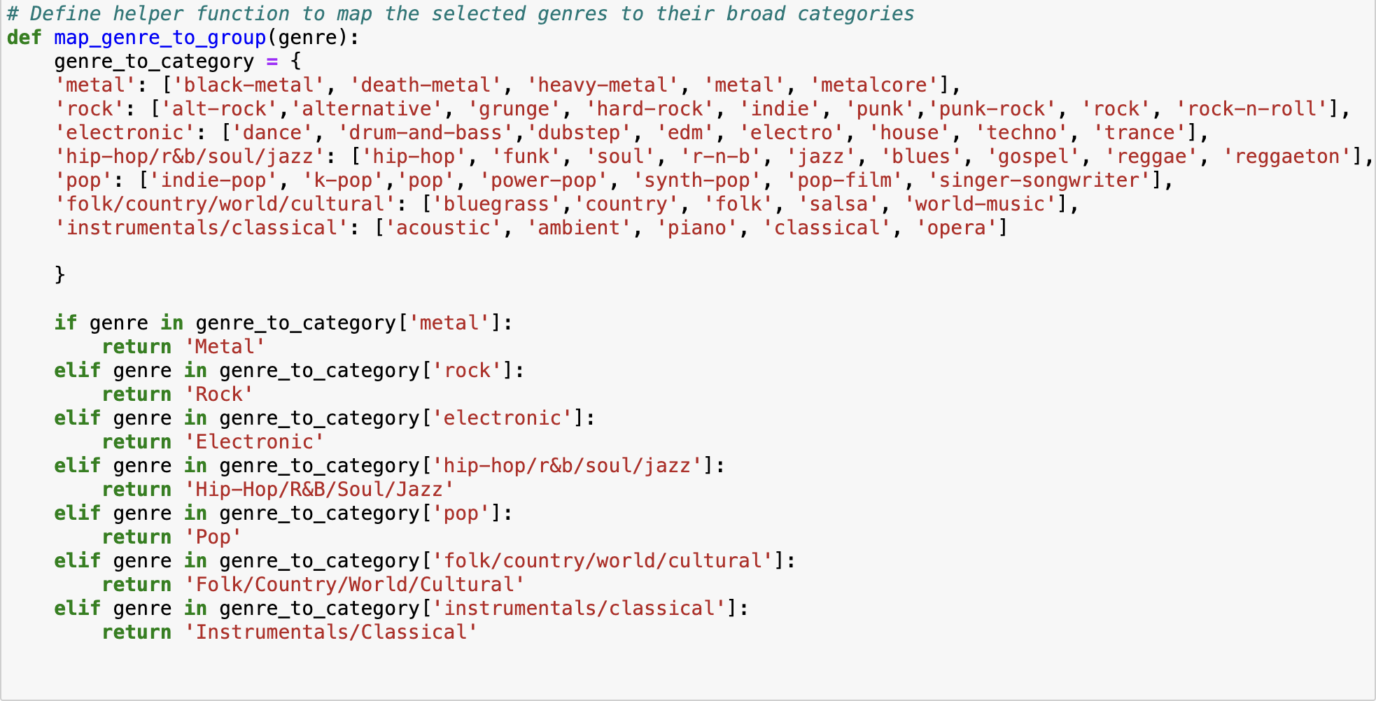
Cleaning up our genres
Data Prep & EDA
Search
Mapper Function
Home
Library
With 7 categories, our model accuracy can be much better

Slide 17
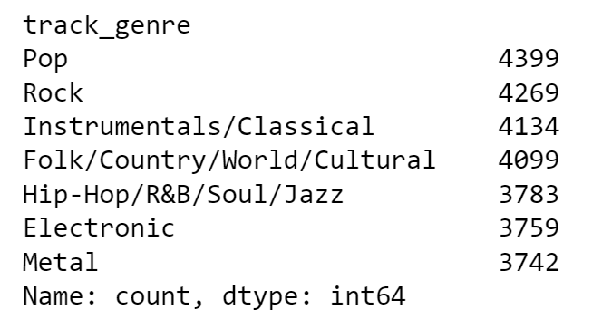
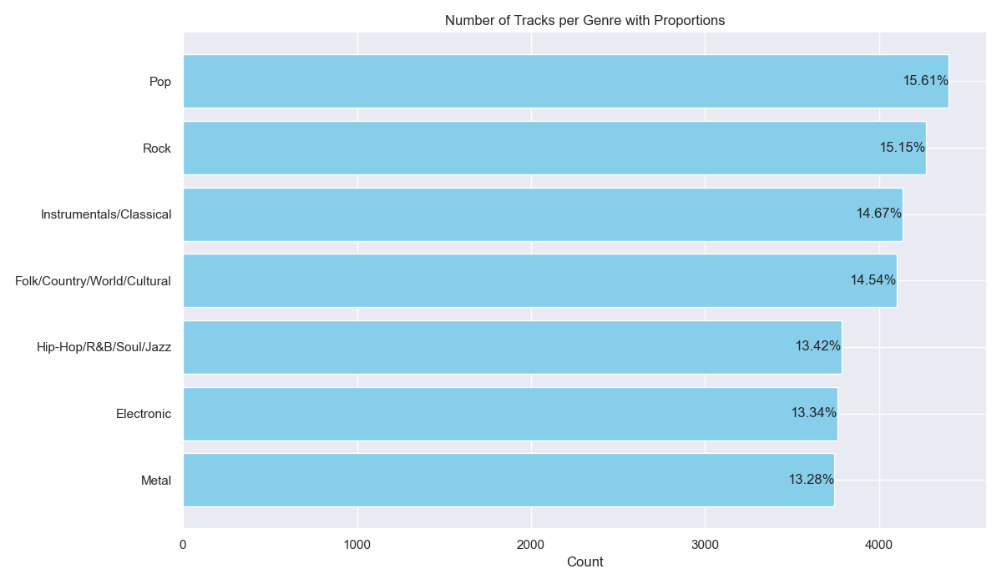
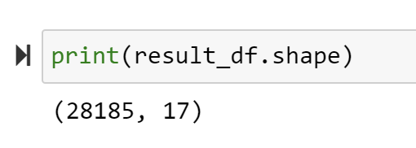
After cleaning
Notes:
Now, let's move onto our practical motivation

Slide 18
Univariate Visualisation
Search
Home
Library
Notes:
Now, let's move onto our practical motivation

Slide 19
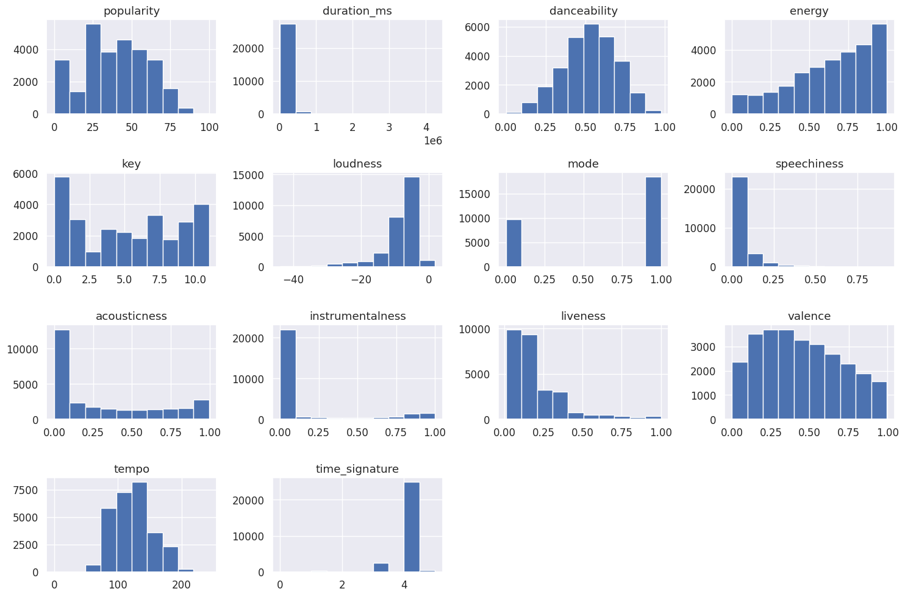
Search
Home
Library
Notes:
Now, let's move onto our practical motivation

Slide 20
Bivariate Exploration
Search
Home
Library
Notes:
Now, let's move onto our practical motivation

Slide 21
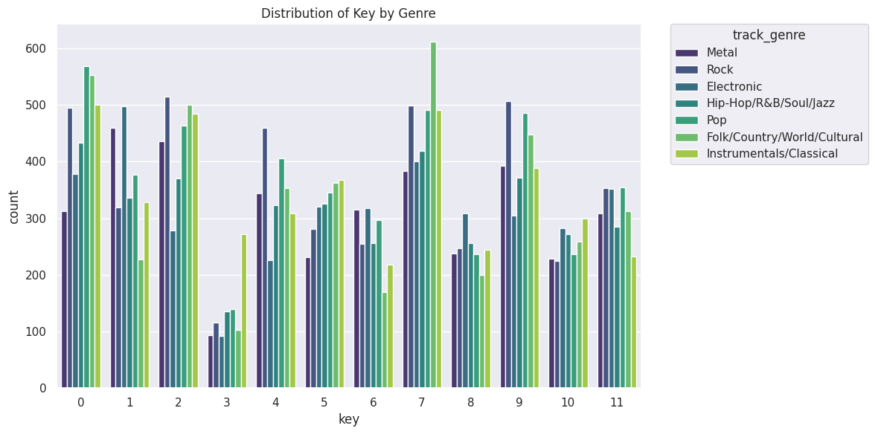
Features we keep
Feature Selection
Search
e.g. Key
Home
Library
High inter-group variance

Slide 22
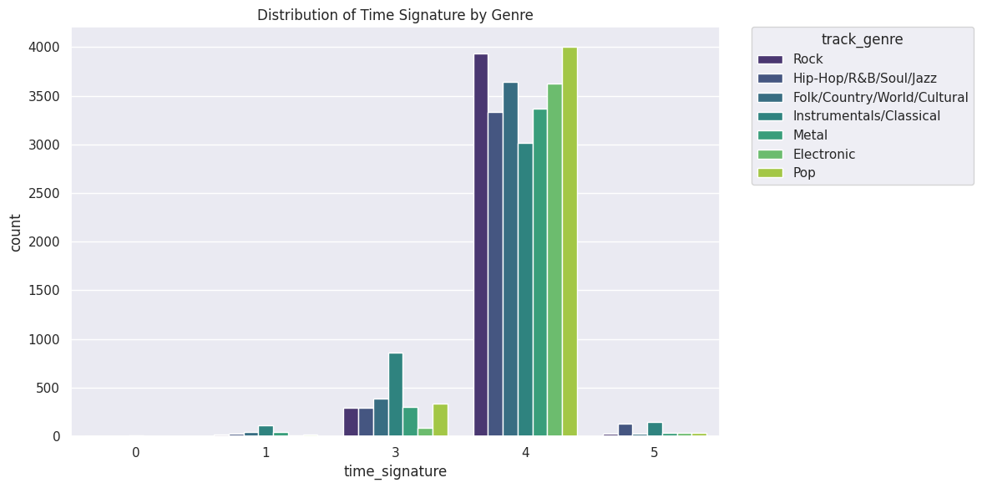
Features we keep
Feature Selection
Search
e.g. Time Signature
Home
Library
High inter-group variance

Slide 23
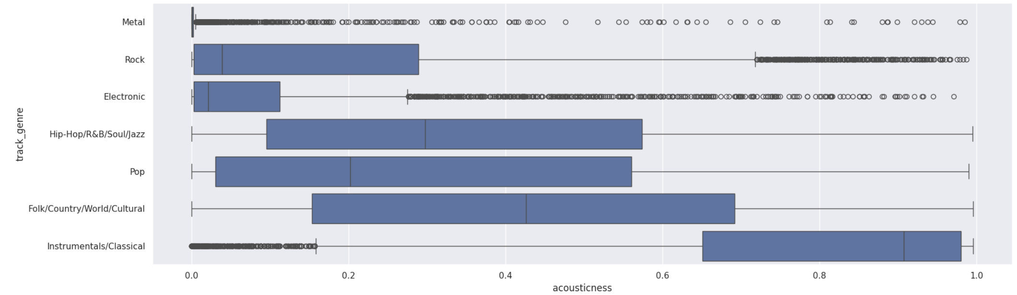
Features we keep
Feature Selection
Search
e.g. Accousticness
Home
Library
High inter-group variance

Slide 24
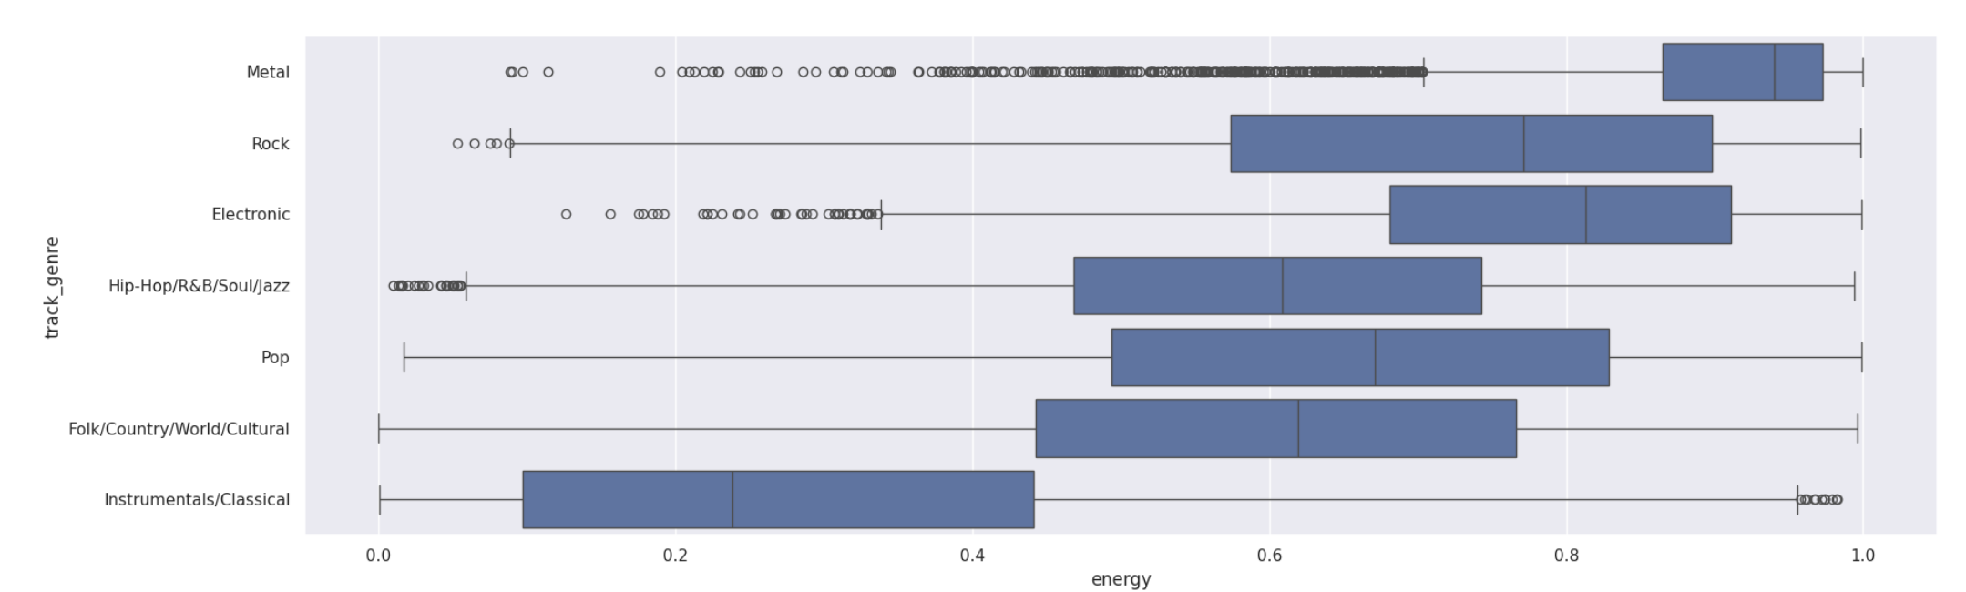
Features we keep
Feature Selection
Search
e.g. Energy
Home
Library
High inter-group variance

Slide 25
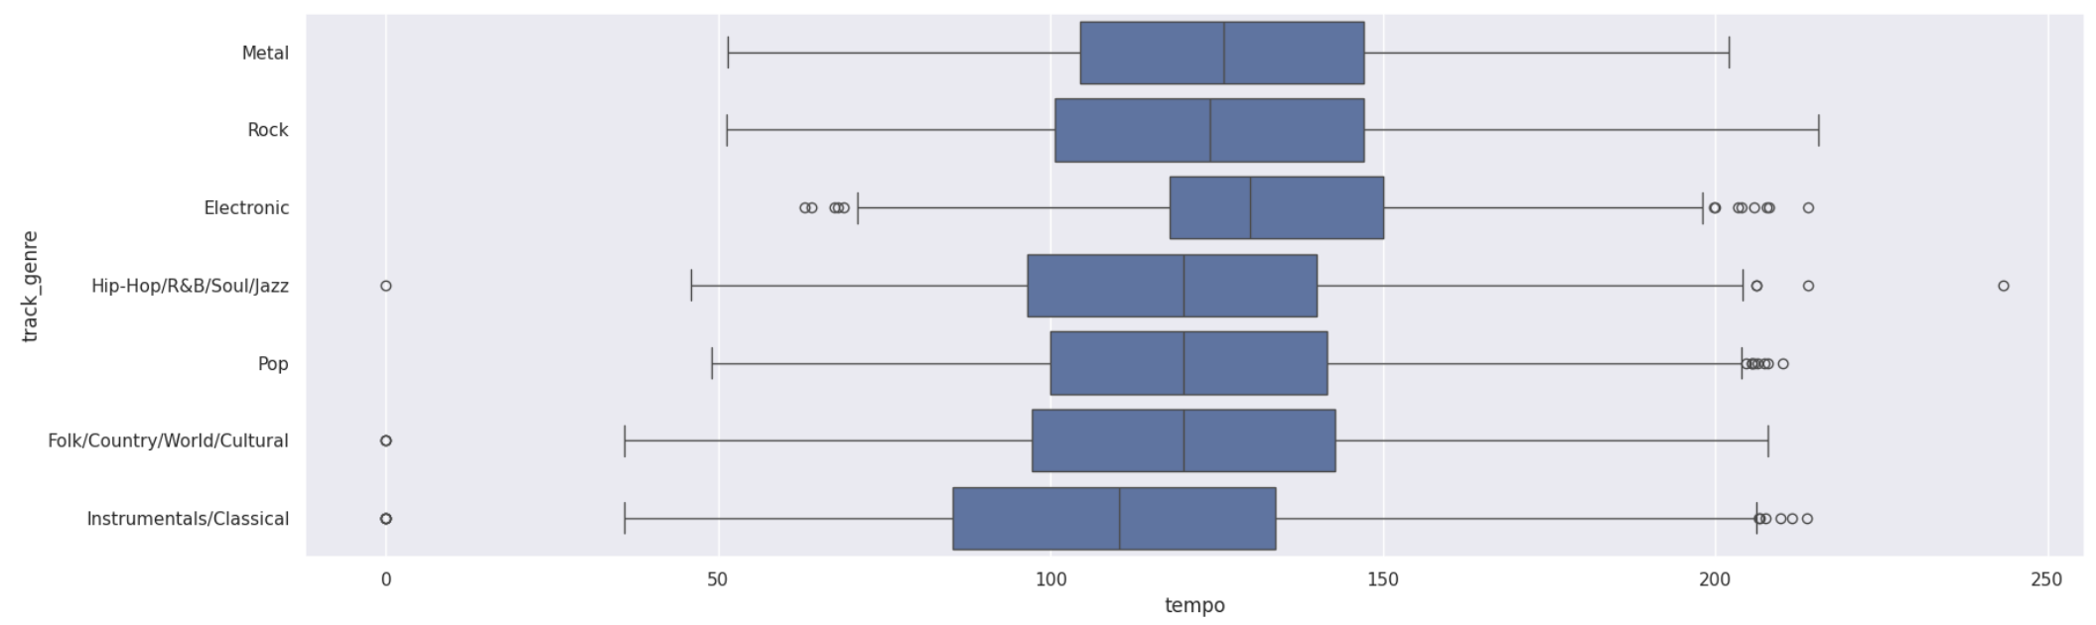
Features we exclude
Feature Selection
Search
e.g. Tempo
Home
Library
Low inter-group variance

Slide 26
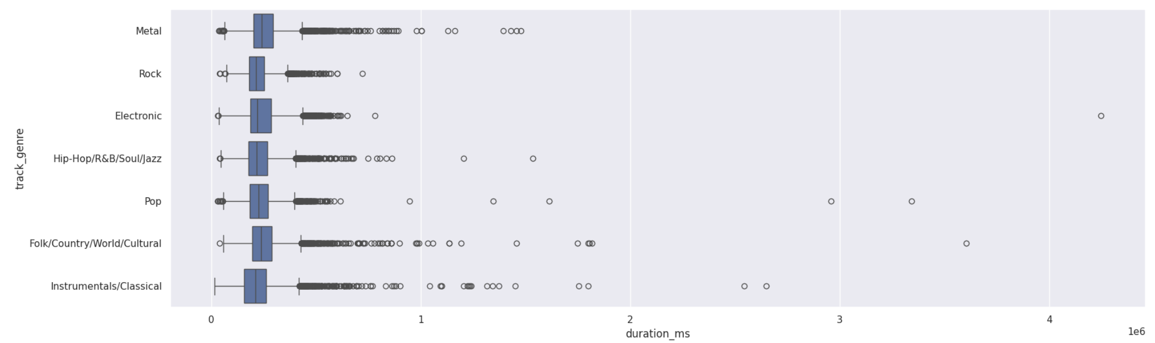
Features we exclude
Feature Selection
Search
e.g. Duration
Home
Library
Low inter-group variance

Slide 27
Data Preprocessing
Search
Home
Library
Notes:
Now, let's move onto our practical motivation

Slide 28
Feature Scaling
Continuous Features
Categorical Features
Standard Scaler
Full playlist
e.g. Energy, Instrumentalness
Adjust to Mean μ = 0 and Standard Deviation σ = 1
One-Hot Encoding
Full playlist
Convert into new columns with corresponding binary mappings
e.g. Key, Artists, Time Signature

Slide 29
Machine Learning Techniques
Search
Home
Library
Notes:
Now, let's move onto our practical motivation

Slide 30
Compared Three Models
XGBoost Classifier
3:15
Popular gradient boosted trees used in classification task
Random Forest
3:20
Combines the output of multiple decision trees into a single result.
Multinomial Logistic Regression
3:10
Classic regression model for multi-class problem
Notes:
XGBoost is a popular gradient boosted trees used in classification task due to its high performance and speed

Slide 31
Summary
Results
Order by
# | Models |  | Accuracy | Recall | Precision
1 |  | Multinomial Logistic Regression | 88.0% | 88.1% | 88.0%
2 |  | XGBoost Classifier | 81.5% | 81.6% | 81.6%
3 |  | Random Forest | 73.9% | 74.0% | 74.1%

Slide 32
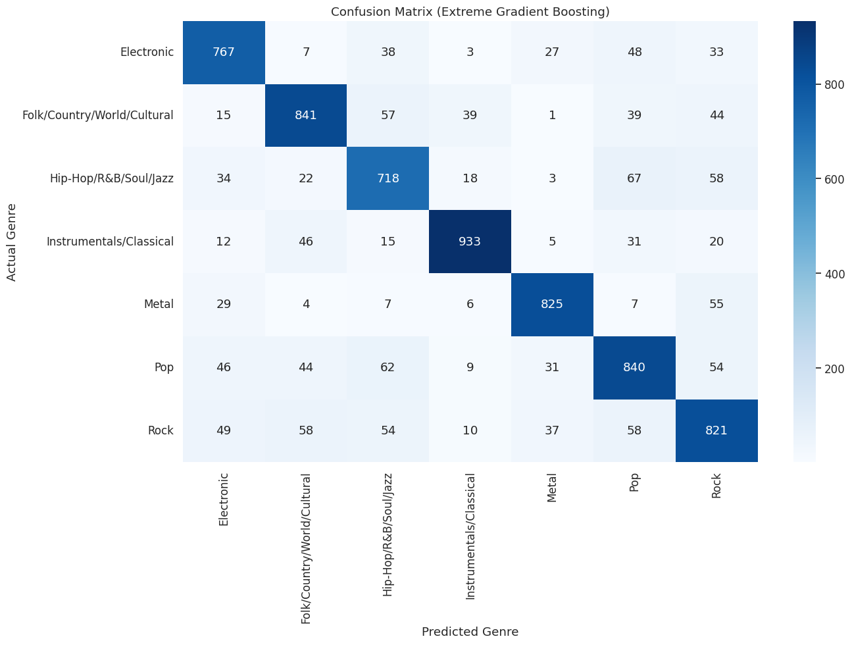

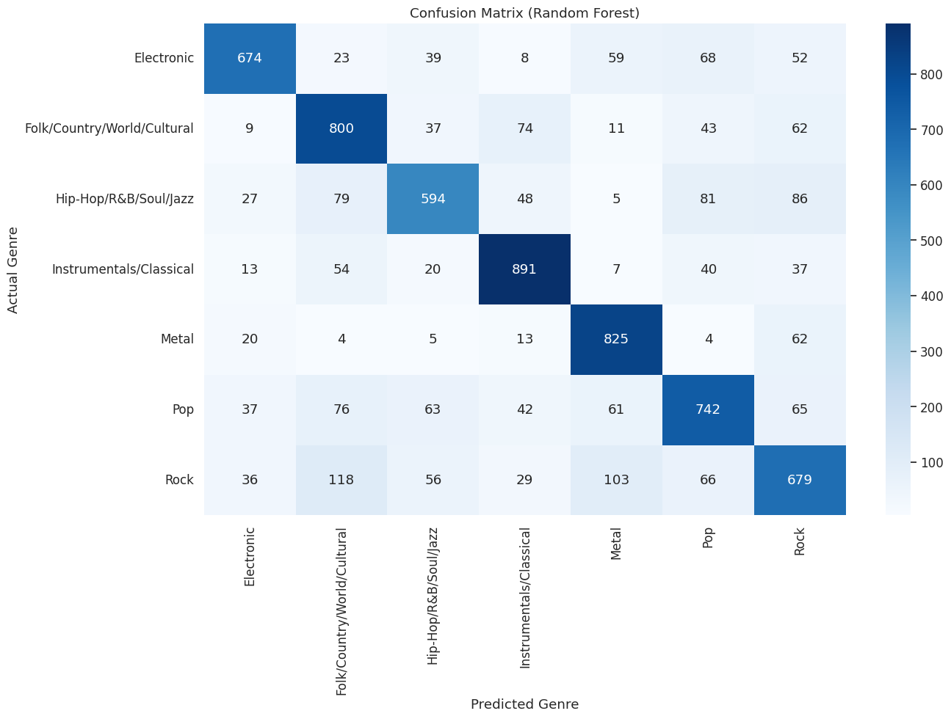
Confusion Matrix
Results
#2 XGBoost
#1 Multinomial Logistic Regression
#3 Random Forest

Slide 33
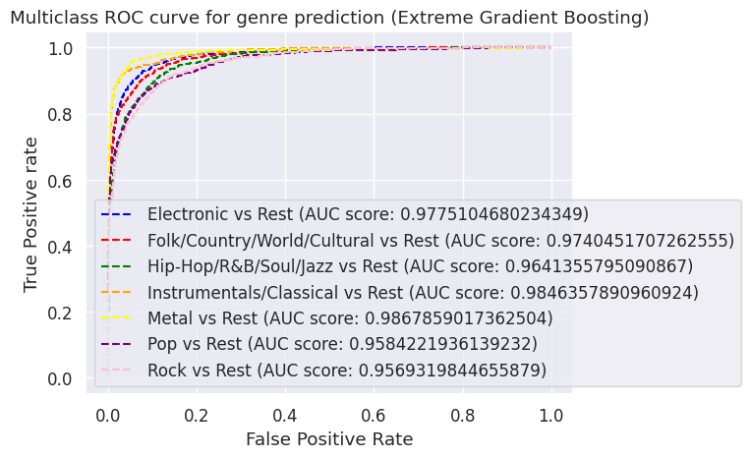
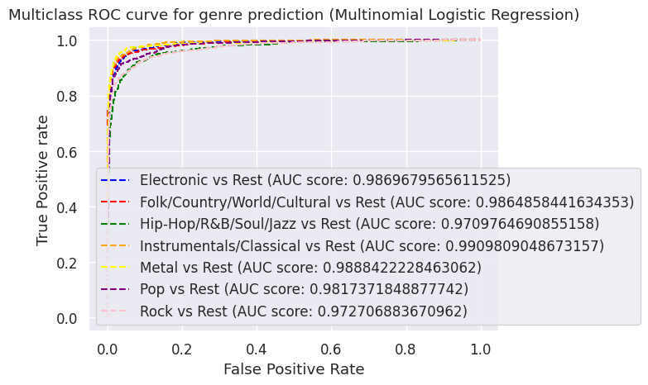
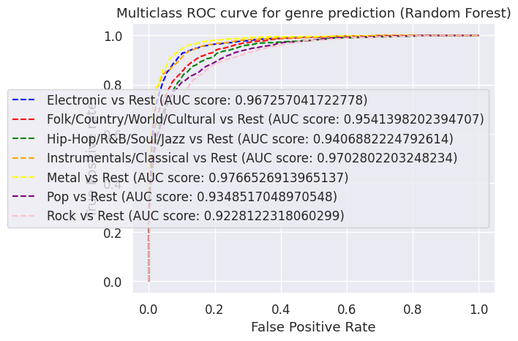
AUC-ROC
Results
“Area Under the Curve” of the “Receiver Operating Characteristic” curve
#2 XGBoost
#1 Multinomial Logistic Regression
#3 Random Forest
Highest degree of separability

Slide 34
Results
Insights
Search
Home
“Simplest model can also do the job”
Library
— FDDA Group 5

Slide 35
Part 2: Music Popularity Model
Our Music Playlists
Search
Home
Library

Slide 36
Popularity Vs the Rest
Data Prep & EDA
Search
Home
Library
Notes:
Now, let's move onto our practical motivation

Slide 37
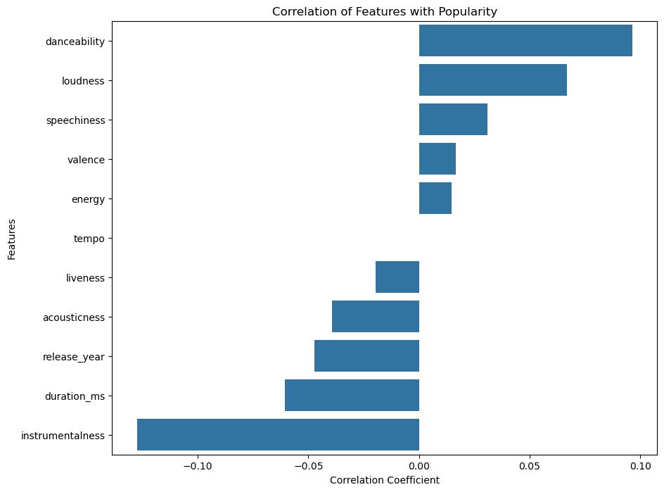
Data Prep & EDA
Search
Home
Library
Notes:
Now, let's move onto our practical motivation

Slide 38
Data Prep & EDA
Thoughts
Search
Home
“So how do we find out which features are more important?”
Library
— FDDA Group 5

Slide 39
Machine Learning Techniques
Search
Home
Library
Notes:
Now, let's move onto our practical motivation

Slide 40
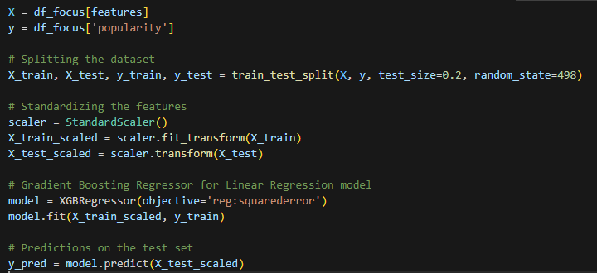
(XGBoost) Regression model
Machine Learning
Search
Home
Library

Slide 41
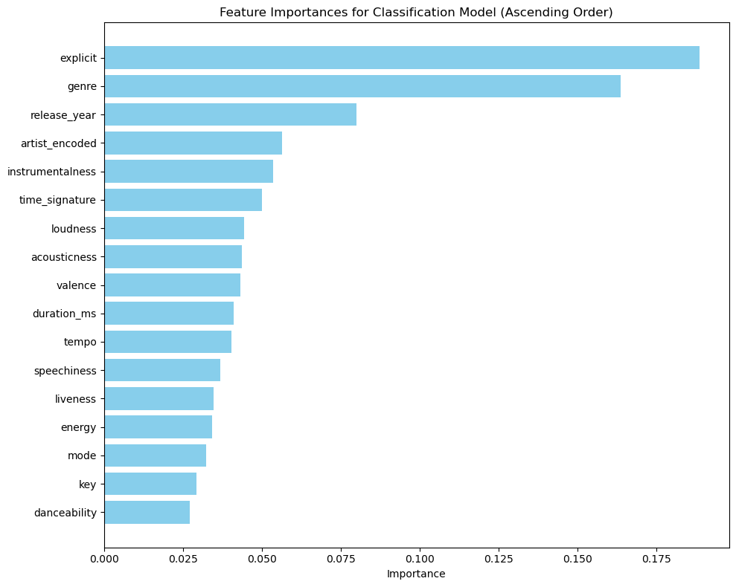
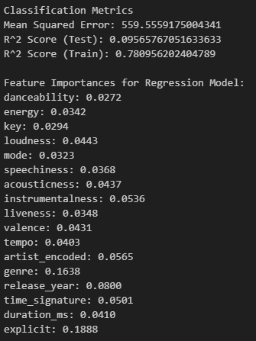
Results
Machine Learning
Search
Home
Library

Slide 42
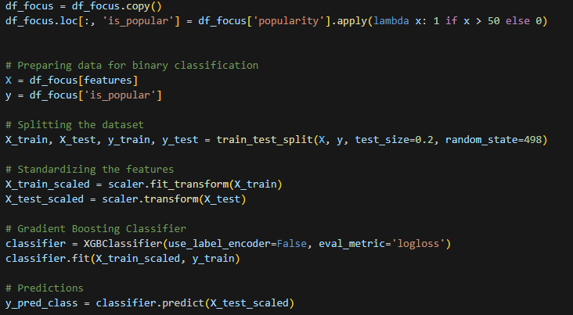
(XGBoost) Classification model
Machine Learning
Search
Home
Library

Slide 43
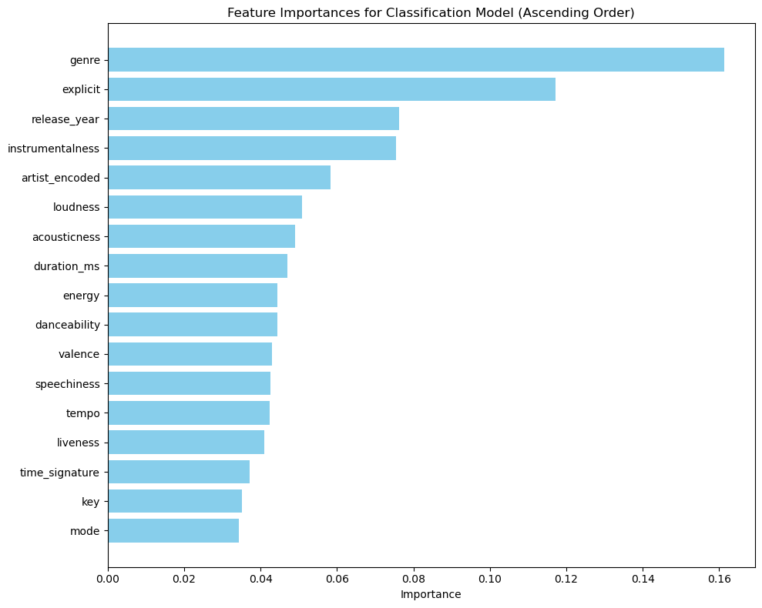
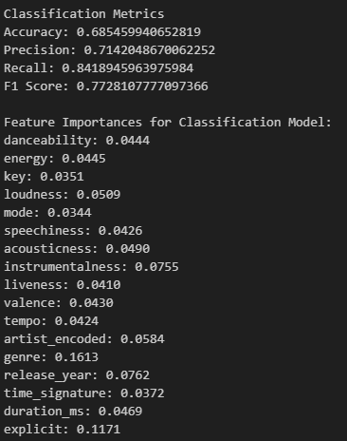
Results
Machine Learning
Search
Home
Library

Slide 44
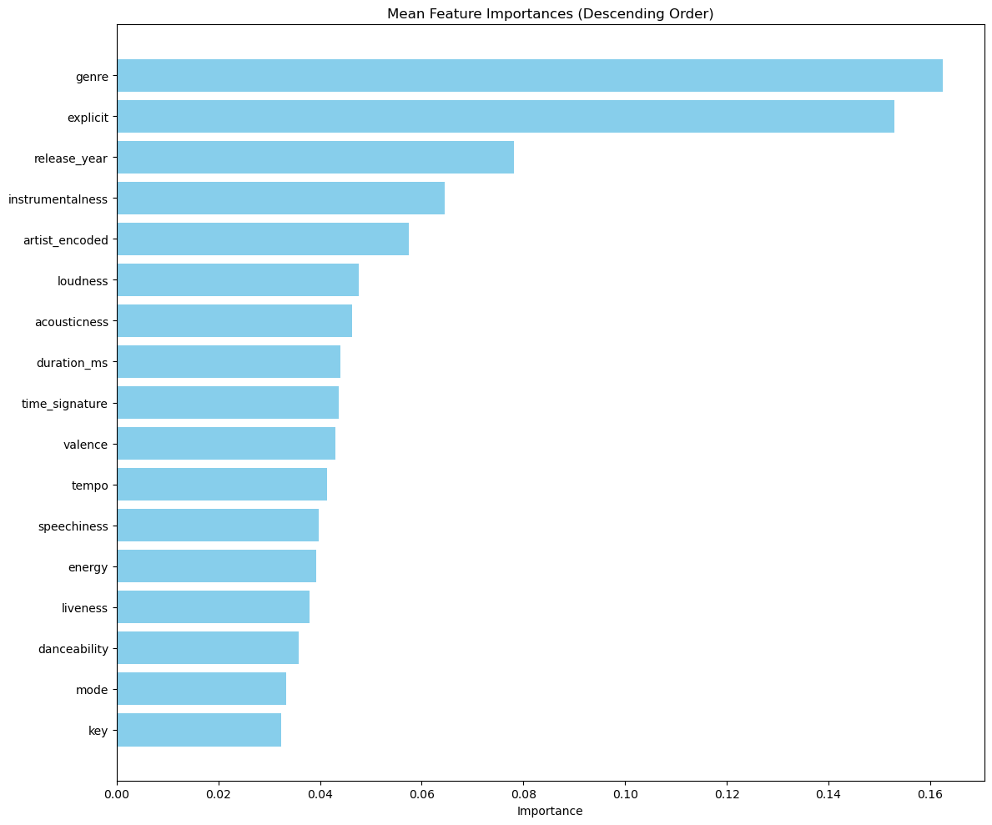
Mean Importance
Machine Learning
Search
Home
Library

Slide 45
Results
Top 5 factors
Search
Home
Music genre
Explicit lyrics
Release year
Instrumentalness
Song artist
Library

Slide 46
Results
Insights
Search
Home
Music genre: one’s preference in music
Explicit lyrics: attract eyeball attention
Release year: stronger impression and easiness of music distribution
Instrumentalness: popular songs generally contain vocals
Song artist: accumulated fame
Library

Slide 47
Part 3: Our recommender systems
Our Music Playlists
Search
Home
Library

Slide 48
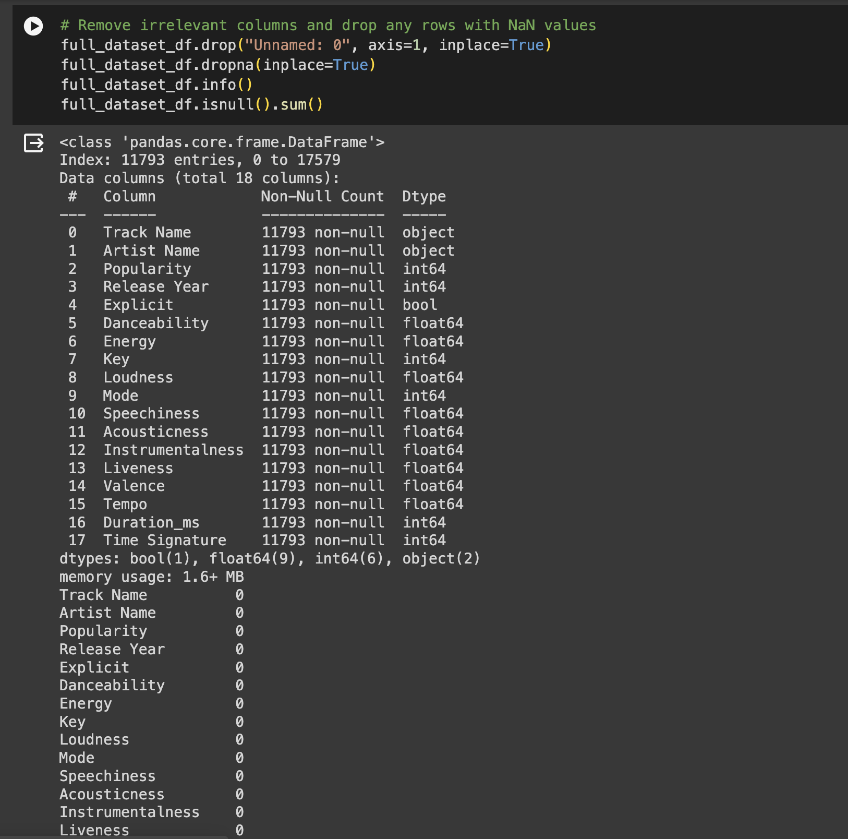
Normal Cleaning
Data Prep and EDA
Search
Home
Since this was our own curated dataset, not much cleaning was required
Library

Slide 49
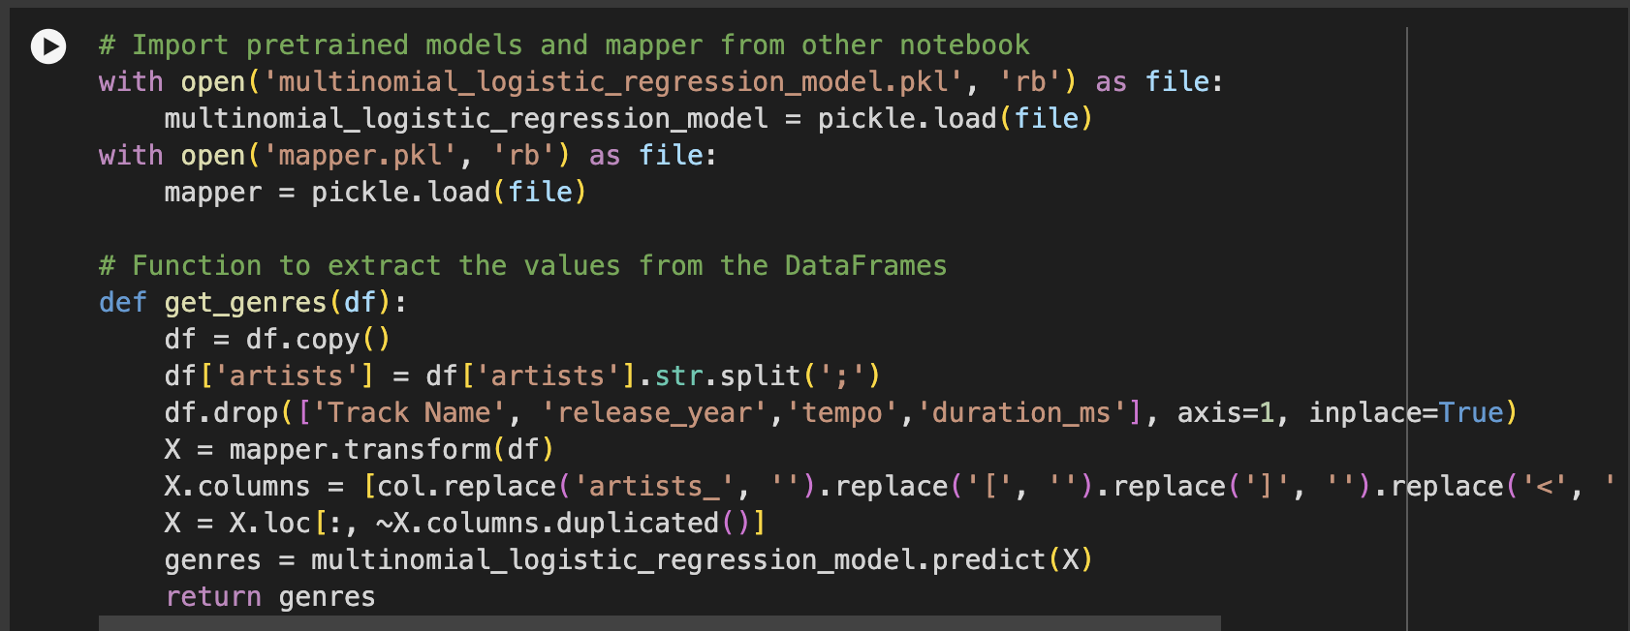
Adding in our Genres
Data Prep and EDA
Search
Home
Import our mapper and model
Apply the model and drop any NaN values
Library

Slide 50
Machine Learning Techniques
Search
Home
Library
Notes:
Now, let's move onto our practical motivation

Slide 51
Autoencoders
Search
Home
Library
Bottleneck
Encoder
Decoder
Notes:
Our first machine-learning technique would be the use of Autoencoders. Autoencoders are made out of 2 sections: an encoder and a decoder. The encoder scales down the features until it hits a minimum point (a bottleneck). The decoder will then take this input and try to reconstruct the original signal. While training this model, the decoder and encoder will work hand-in-hand to minimise the size of the features, while making it re-constructable. This essentially helps to compress the data with minimal information loss.

Slide 52
K-Nearest Neighbours
Machine Learning
Search
Home
Library
Notes:
The next machine learning technique we used is the K-Nearest Neighbours model. We used this as a content-based filtering technique for our model

Slide 53

K-Nearest Neighbours
Machine Learning
Search
Home
Library
Notes:
K-Nearest Neighbours is a simple algorithm that finds the closest "neighbours" to a certain point to classify an item.

Slide 54







K-Nearest Neighbours
Machine Learning
Search
Home
Library
(Average playlist song)
Notes:
Here, we altered its normal use in classification for our recommendation system. We simply take the average of the song vectors in the playlist, and find the nearest 5 songs from our dataset to that vector. There are a few popular distance metrics used, but we found that the cosine distance metric worked the best for our recommendation system.

Slide 55
Our models
Baseline model
Weighted Model
Our Normal K-NN model
Baseline model with adjusted weights
Dropped Model
Unweighted Autoencoder
Baseline model with selected features dropped
Baseline model with Unweighted Autoencoder
Weighted Autoencoder
Baseline model with Weighted Autoencoder
Notes:
With all that, here we have our 5 models for comparison. On top of testing the efficacy of each dimensionality reduction technique, we also tested how our weighting the selected features based on popularity would affect the quality of recommendations.

Slide 56
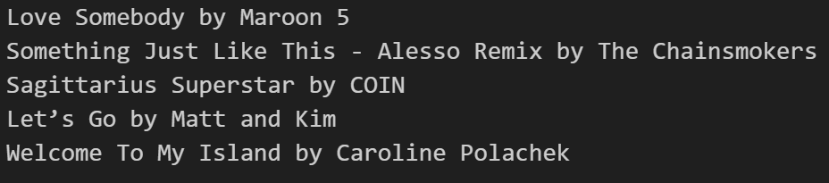
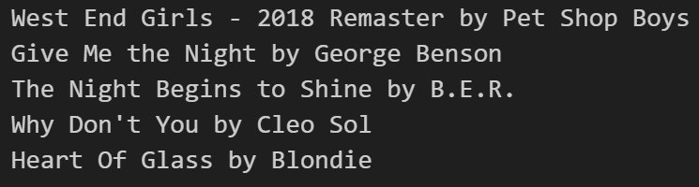
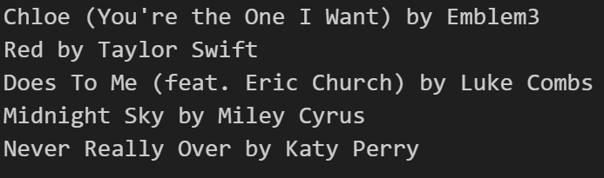
Our models
Baseline model
Dropped Model
Weighted Autoencoder
Notes:
With all that, here we have our 5 models for comparison. On top of testing the efficacy of each dimensionality reduction technique, we also tested how our weighting the selected features based on popularity would affect the quality of recommendations.

Slide 57
Survey Results
Sample size of 10 users
Ranking | Models |  | Ratings
1 |  | Baseline model with adjusted weights | 7.04
2 |  | Baseline model with the weighted autoencoder | 6.9
3 |  | Baseline model | 6.74
4 |  | Baseline model with the unweighted Autoencoder | 6.06
5 |  | Baseline models with worst features dropped | 4.7
Notes:
With all that, here we have our 5 models for comparison. On top of testing the efficacy of each dimensionality reduction technique, we also tested how our weighting the selected features based on popularity would affect the quality of recommendations.

Slide 58
Results
Insights
Search
Home
Weighted Autoencoders can improve efficiency without significant performance cost
Combination of Content-based and Collaborative filtering can enhance model robustness.
Library

Slide 59
Results
Insights
Search
Home
Use of unstructured data such as audio and lyric could improve the quality of recommendations.
Similar dimensionality reduction techniques like Mel-Frequency Cepstral Coefficients (MFCCs) [3] and Singular Value Decomposition (SVD) to encode audio and lyric data respectively. [4]
Library

Slide 60
Reference
[1] M. Schedl, ‘Deep Learning in Music Recommendation Systems’, Front. Appl. Math. Stat., vol. 5, doi: 10.3389/fams.2019.00044.
[2] V. Tiwari, "MFCC and its applications in speaker recognition," International Journal on Emerging Technologies, vol. 1, no. 1, pp. 19-22, 2010.
[3] P. C. Hansen, "The truncatedSVD as a method for regularization," BIT Numerical Mathematics, vol. 27, no. 4, pp. 534-553, 1987. doi: 10.1007/BF01937276.
Kaggle Dataset: MaharshiPandya, “spotify tracks dataset,” Kaggle, https://www.kaggle.com/datasets/maharshipandya/-spotify-tracks-dataset/data (accessed Apr. 23, 2024).

Slide 61
Thank You!
Our Music Playlists
Search
Home
Library
Please keep this slide for attribution

